Slide 1
Project on HIV Destigmatization in the Marriage Equality Movement in Taiwan
Sih-Cheng (Sean) Du,
Chih-Liu (Leo) Peng, Mei-Ying Juan,
Chi-Wei Cheng, Chia-Wei Chang, Chia-Wei Hsu
Taiwan Tongzhi (LGBTQ+) Hotline Association

Slide 2
Background

Slide 3
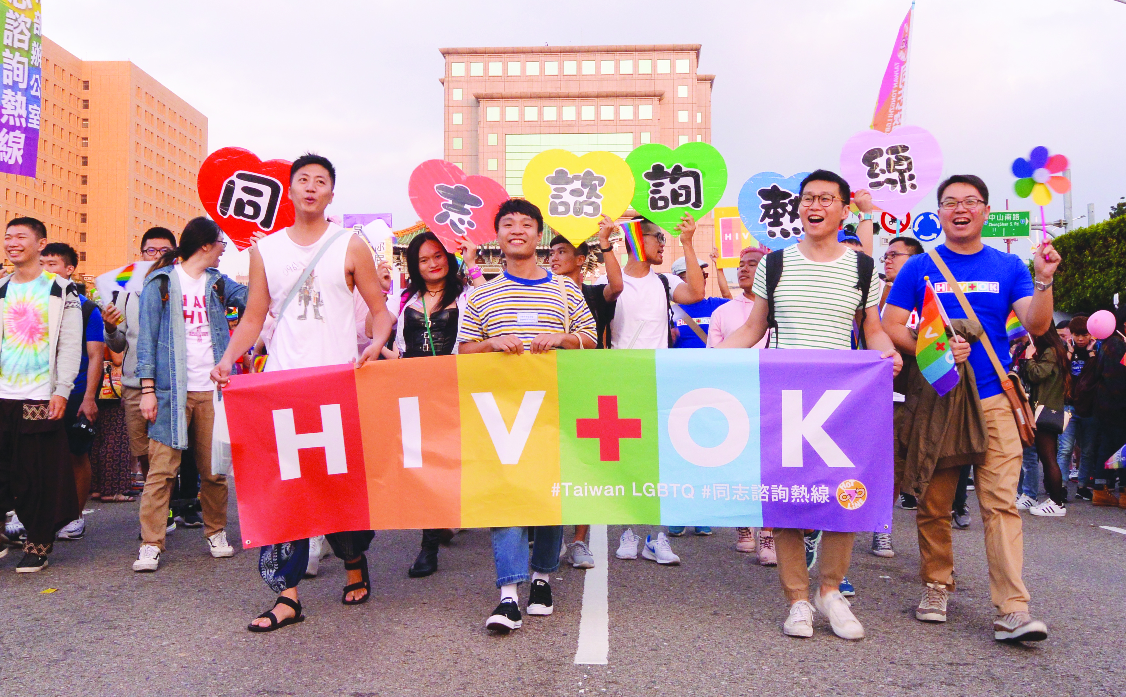
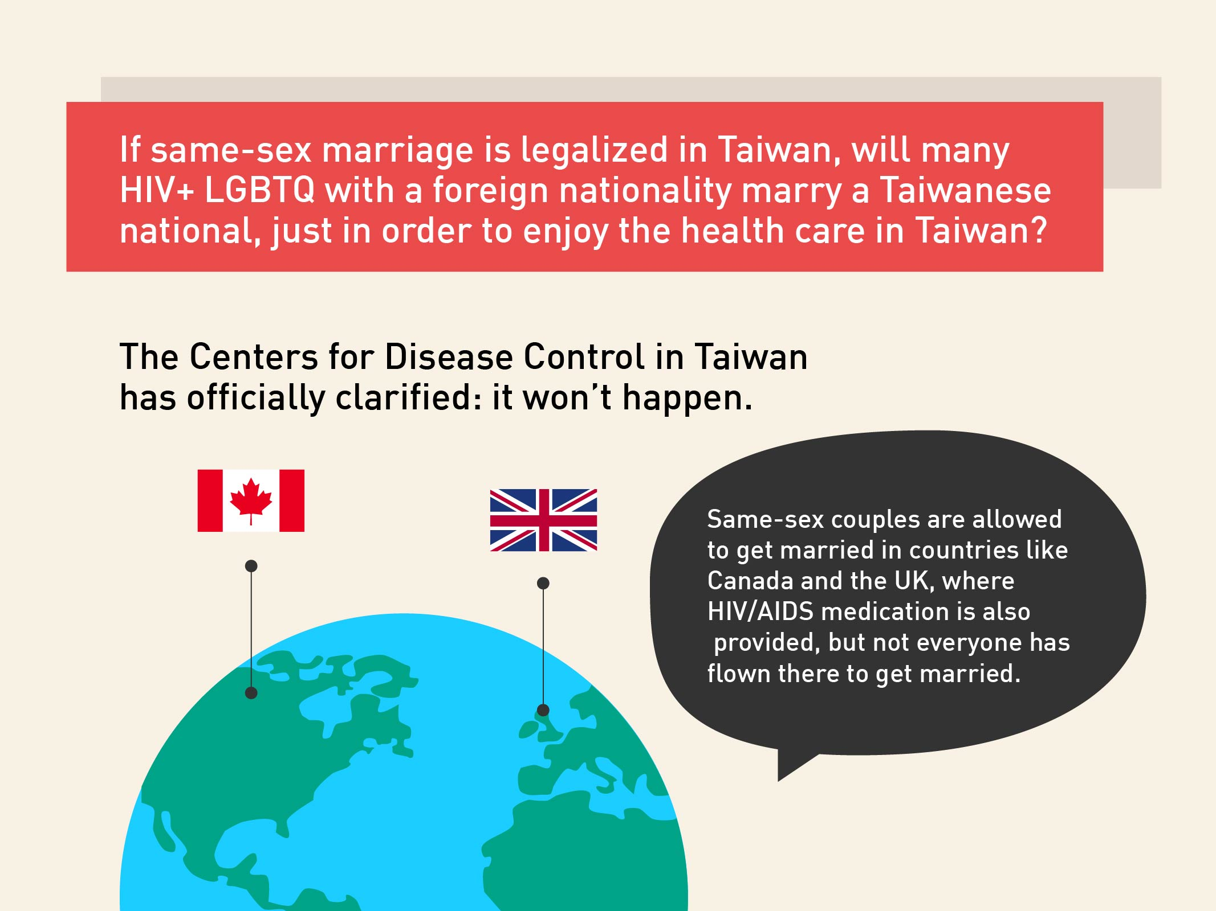
Description and Lesson Learned

Slide 4
Conclusion / Next steps
Adult education
Solidarity of different movements
Infographics and new technology

Slide 5
Thank you
This project has no conflict of interest.
Sih-Cheng (Sean) Du
Taiwan Tongzhi (LGBTQ+) Hotline Association
E-mail: xiaodu@hotline.org.tw
Web: https://hotline.org.tw
FB: TaiwanHotline

